Slide 1


Slide 2

Task: Think of 3 family members,
what do they do as a job? Add 3 facts about their about their job
Careers family tree

Slide 3
Public Services
Education, Training and childcare
Health and social care
Performing arts
Retail and customer service
Travel and Tourism
What jobs can you think of that come
under these headings?
Art, photography and design
Hairdressing and Barbering
Environment, Animals and plants
Job sectors

Slide 4
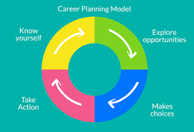
Year 9
During the week complete the following activities and add your findings to the showbie group National careers Week 2025.
Find the careers section in the school library and jot down one title you are interested in.
Pick your favourite careers quotes, either from those sent to you or one of your own
I want to be…… frame
Home school conversations
Think about jobs that come under different sectors- this can be as a class or individually
Hope assembly powerpoint
Activities

Slide 5

Have a look at the following careers apps-
Sparkapp - https://www.sparkcareers.org/
https://wouldyouratherbe.com/
Qdos – https://qdos-career-hub.com/qdos-careers-app
Links/apps

