Slide 1


National Apprenticeship Week 2025
The 18th annual week-long celebration of apprenticeships will be taking place between 10th-16th February 2025.
Aims: Take part in the activities and expand your understanding
#skillsforlife

Slide 2
During the week …..
Skills for Life
The theme for National Apprenticeship Week 2025 will be ‘skills for life’.
A chance to reflect on how apprenticeships can help individuals to develop the skills and knowledge required for a rewarding career.
Businesses then benefit from a talented workforce that is equipped with future-ready skills.
For us in school it is a great opportunity to talk and learn about what an apprenticeship is and to think about whether it is a potential future pathway for you.

Slide 3

Sixth form
Over the week please explore the various websites
https://nationalapprenticeshipweek.co.uk/resource-hub//
https://www.nationalapprenticeshipweek.co.uk/degree-apprenticeships/
https://www.nationalapprenticeshipweek.co.uk/doing-an-apprenticeship-after-a-degree/

Slide 4
Companies recruiting apprentices
KPMG
https://www.kpmgcareers.co.uk/search
Whether you’re in your final year of school or college, or looking for a new career opportunity, join KPMG as an apprentice in Audit, Consulting, KPMG Business Services, Law or Technology & Engineering and you’ll receive the training, qualifications, work experience and support you need to thrive.
KPMG Apprenticeship Programmes
With programmes available across the UK, you’ll have the opportunity to earn and learn, be part of our collaborative community of people – and be inspired to build your own extraordinary career full of exciting possibilities.
Places fill fast, so we'd encourage you to apply as soon as possible.

Slide 5

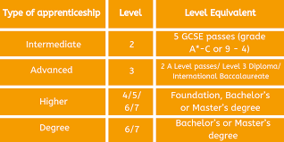
Police
https://www.met.police.uk/car/careers/met/police-officer-roles/police-constable/overview/entry-routes/
Richmond Hill hotel apprenticeship academy
https://www.richmondhill-hotel.co.uk/careers
British Telecoms
https://www.bt.com/careers/early-careers/apprentices
https://www.aon.com/careers/early-careers/uk/apprenticeships
Apprenticeship opportunities
https://careermap.co.uk/careers/apprentice
https://www.nationalapprenticeshipweek.co.uk/events/

Slide 6
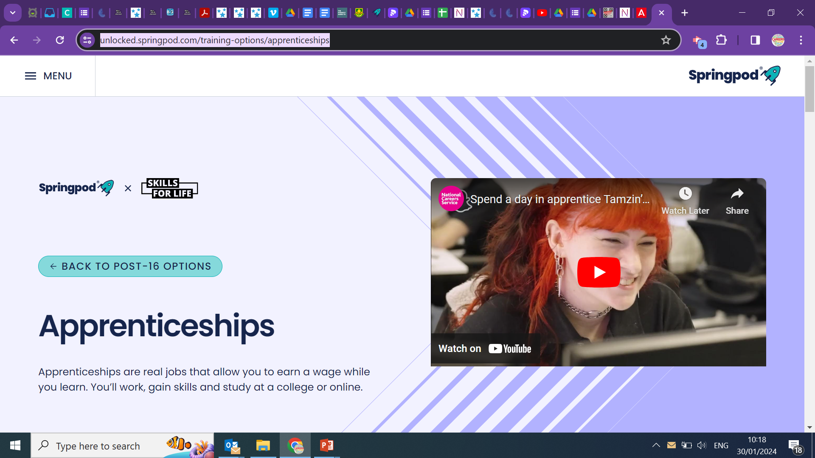
Not sure about your next steps after sixth form?
Have a look at this short information course to find out more about apprenticeships and degree apprenticeships
https://unlocked.springpod.com/
https://unlocked.springpod.com/training-options/apprenticeships

Slide 7



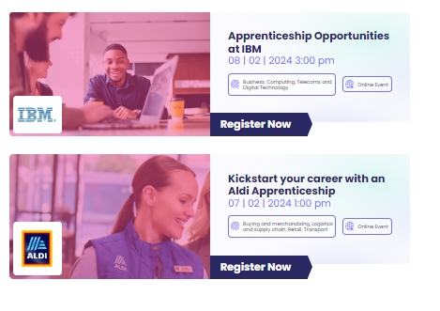

National Apprenticeship Week Events 2025
https://nationalapprenticeshipweek.co.uk/events//

Slide 8
Thank you

