Slide 1


National Apprenticeship Week 2025
The 18th annual week-long celebration of apprenticeships will be taking place between 10th-16th February 2025.
Aims: Take part in the activities and expand your understanding
#skillsforlife

Slide 2

During the week …..
Skills for Life
The theme for National Apprenticeship Week 2025 will be ‘skills for life’.
A chance to reflect on how apprenticeships can help individuals to develop the skills and knowledge required for a rewarding career.
Businesses then benefit from a talented workforce that is equipped with future-ready skills.
For us in school it is a great opportunity to talk and learn about what an apprenticeship is and to think about whether it is a potential future pathway for you.

Slide 3
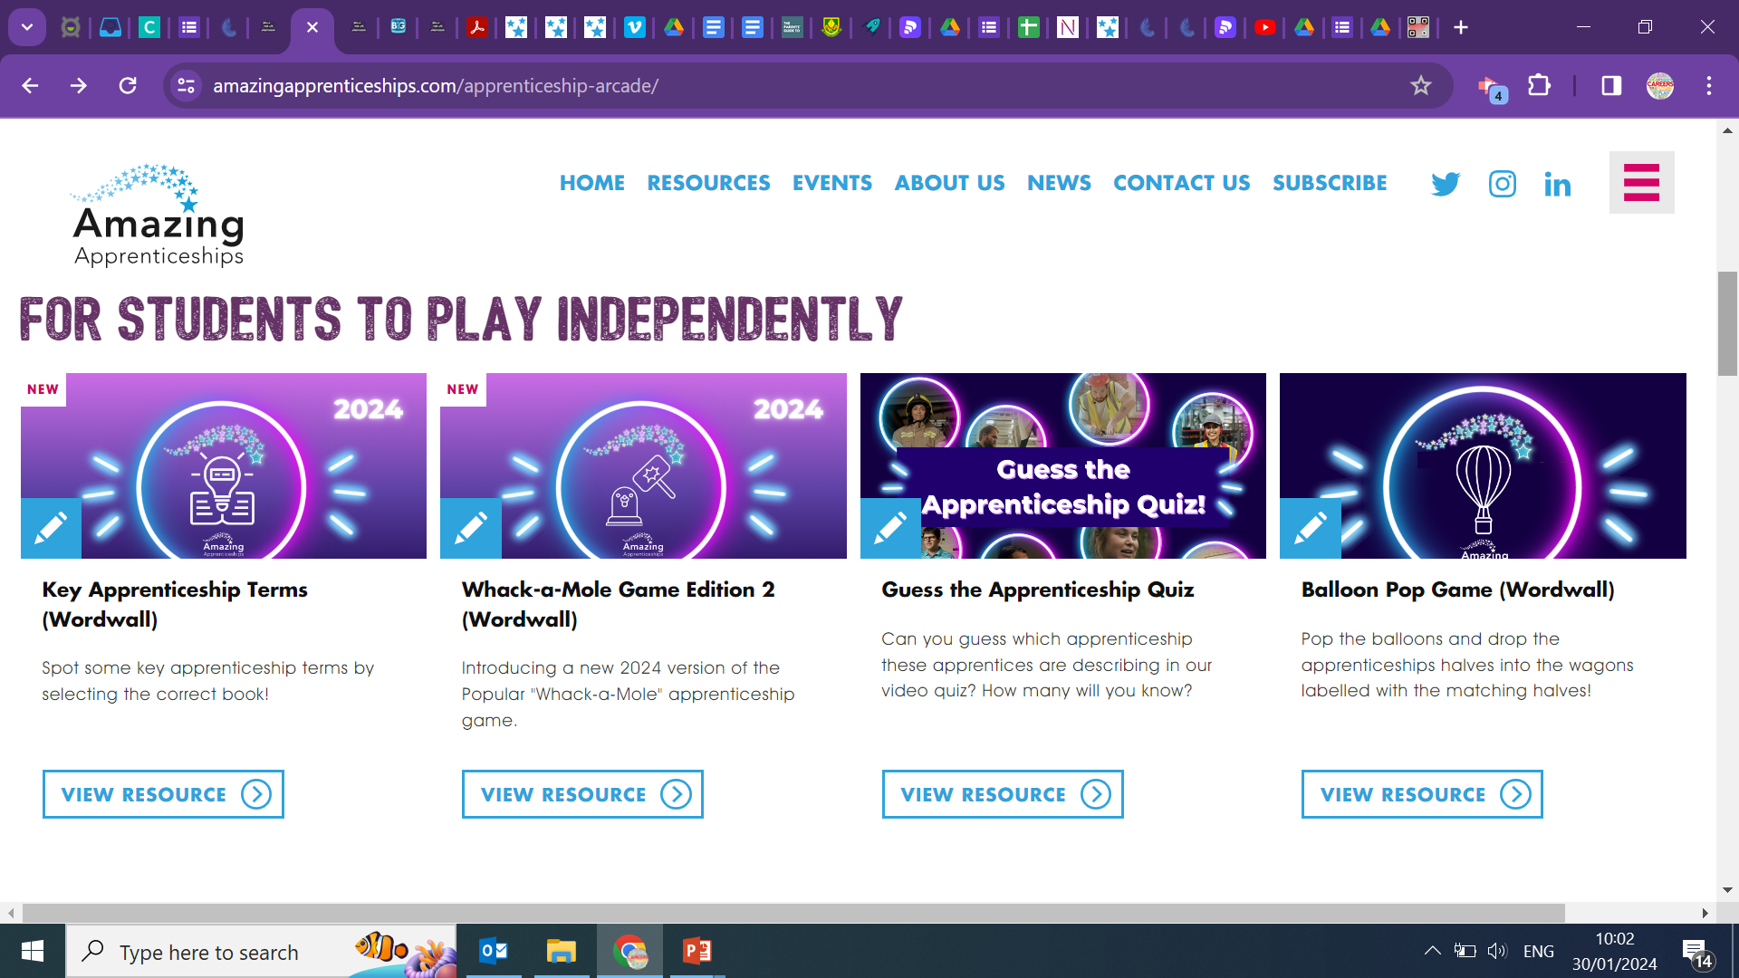
Year 9
Task: Discuss advantages and disadvantages to apprenticeships
Play the key apprenticeship terms and whack a mole games via the apprenticeships resources page.
https://amazingapprenticeships.com/apprenticeship-arcade/
Watch videos and discuss
Apprenticeship subject links click here
To search different apprenticeships click here
Apprenticeship real stories click here
Apprenticeship quiz click here

Slide 4





National Apprenticeship Week Events 2025
https://nationalapprenticeshipweek.co.uk/events//

Slide 5

The 'Apprenticeship Arcade' features a suite of fun and engaging games for students, with new games added for 2025. https://amazingapprenticeships.com/apprenticeship-arcade

Slide 6
Thank you

