Slide 1

National Apprenticeship Week 2025
The 18th annual week-long celebration of apprenticeships will be taking place between 10th-16th February 2025.
Aims: Take part in the activities and expand your understanding
#skillsforlife
Look out for the poster in classroom and activities in form time across the week

Slide 2

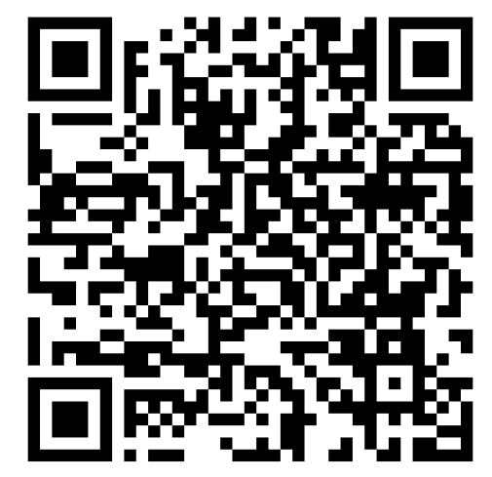
Scan the code and test your knowledge

