Slide 1
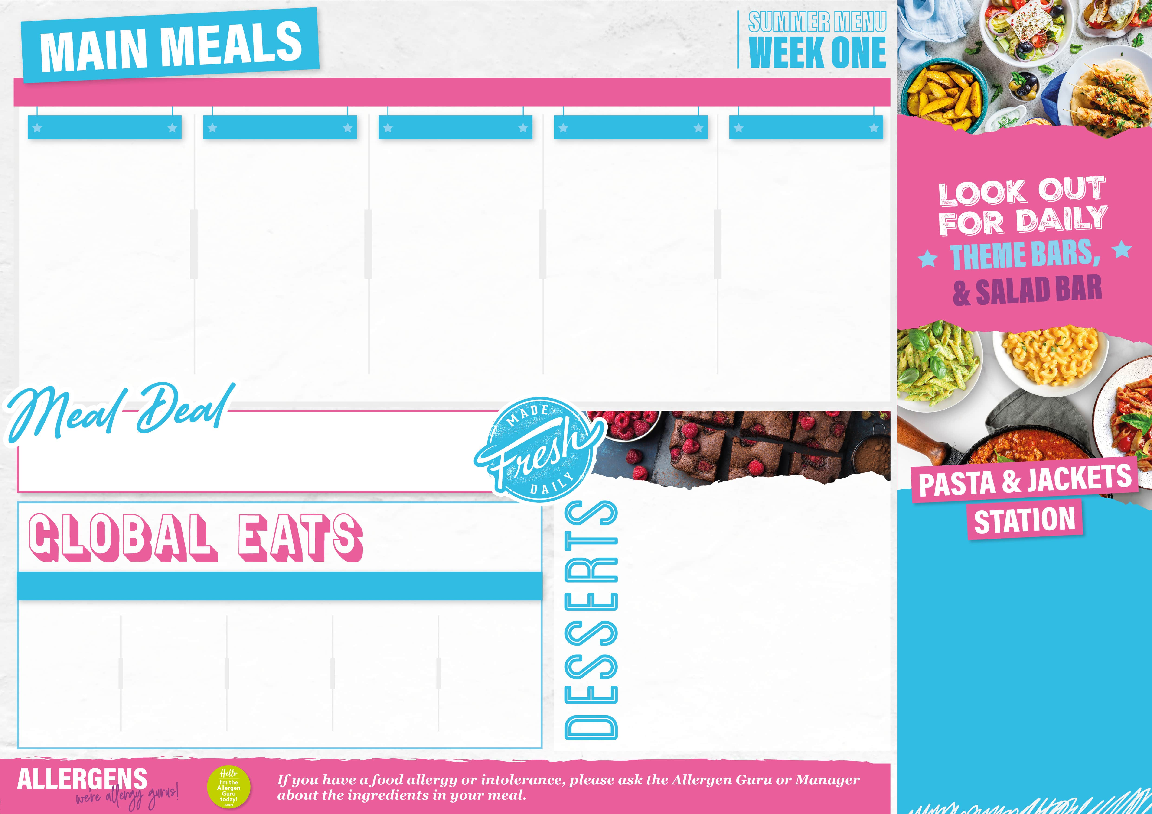
13th April, 4th May,
1^{st & 22nd} June,
From £2.90
A TASTE OF ASIA
MEXICAN MOMENTS
BRITISH CLASSICS
TASTE OF ITALY
CHIP SHOP
Singapore Chicken Laksa Curry Singapore Tofu & Vegetable Laksa Curry Noodles Grean beans | Turkey & pepper Burrito Mixed bean & vegetable Burrito Flour tortilla Rice Corn on the cob Sour cream Salsa | Cumberland sausage Veggie sausage Caramelised onion gravy Creamy mashed potato Carrots Broccoli | Beef bolognese Tomato & lentil ragu Penne pasta Garlic bread Roasted aubergine, peppers & courgette | Battered Fish Fillet Chicken tenders Cheese & Onion Turnover Chips Peas Baked Beans
Only £3.20
Check out what’s on offer today, available for free school meals!
MONDAY
Apple & cinnamon crumble with custard
TUESDAY
Caramelised banana upside down cake
WEDNESDAY
Summer berry flapjack
THURSDAY
Tiramisu sponge
FRIDAY
Double chocolate traybake
From £2.65
MONDAY
Bolognaise, Basil Pesto, Macaroni Cheese, Creamy Chicken & Sweetcorn and Spicy Tomato Arrabbiata
TUESDAY
Bolognaise, Basil Pesto, Macaroni Cheese, Creamy Chicken & Sweetcorn and Spicy Tomato Arrabbiata
WEDNESDAY
Bolognaise, Basil Pesto, Macaroni Cheese, Creamy Chicken & Sweetcorn and Spicy Tomato Arrabbiata
THURSDAY
Bolognaise, Basil Pesto, Macaroni Cheese, Creamy Chicken & Sweetcorn and Spicy Tomato Arrabbiata
FRIDAY
Pizza Mac & Cheese with Garlic Bread
Meatball sub | Cheeseburger | Sweet n sour chicken & rice | Texas BBQ chicken wings & wedges | Hot honey beef & potato bites
From £1.45
From £2.65

Slide 2

20th April, 11th May,
8^{th & 29th} June
From £2.90
SUNSHINE FAVOURITES
CULENRY CLASSICS
MOST OF THE ROAST
TASTE OF MIDDLE EAST
CHIP SHOP
Chicken Katsu Sweet potato Katsu Katsu sauce Steamed rice Garlic & soy cabbage | Turkey Ala King Mushroom & white bean stew Buttered new potatoes Roasted courgettes | Honey roasted Gammon Vegetable wellington Skin on roast potatoes Broccoli Carrots | Lebanese Chicken Shawarma Lebanese Eat Curious Shawarma Lemon & Herb Tabouleh Pitta Bread | Battered Fish Fillet Mince beef & onion pie Vegetable Spring Roll Chips Peas Baked Beans
Only £3.20
Check out what’s on offer today, available for free school meals!
MONDAY
Pear flapjack crumble
TUESDAY
Lemon drizzle sponge
WEDNESDAY
Sticky toffee pudding
THURSDAY
Chocolate brownie
FRIDAY
Cookies & cream sponge
From £2.65
MONDAY
Bolognaise, Basil Pesto, Macaroni Cheese, Creamy Chicken & Sweetcorn and Spicy Tomato Arrabbiata
TUESDAY
Chicken Curry Rice Pot, Chilli Sin Carne Rice Pot
WEDNESDAY
Bolognaise, Basil Pesto, Macaroni Cheese, Creamy Chicken & Sweetcorn and Spicy Tomato Arrabbiata
THURSDAY
Bolognaise, Basil Pesto, Macaroni Cheese, Creamy Chicken & Sweetcorn and Spicy Tomato Arrabbiata
FRIDAY
Crunchy Cauliflower Mac and Cheese with Garlic Bread
Cheeseburger | Currywurst with Fries | Sweet n sour chicken with rice | Crispy chicken wrap | Buffalo chicken wings & wedges
From £2.65
From £2.65

Slide 3
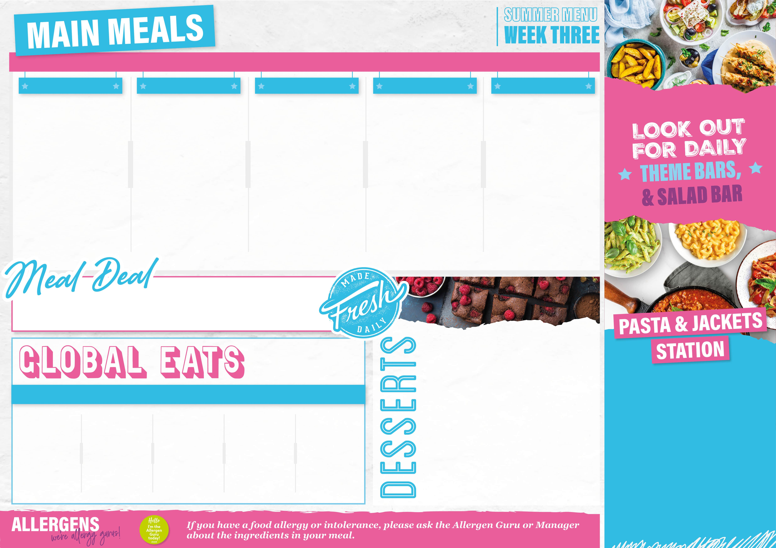
27th April, 18th May, 15th June, 6th July
From £2.90
Sunshine favourites
ORIENT EXPRESS
MOST OF ROAST
MEXICAN MOMENTS
CHIP SHOP
Caribbean chicken Caribbean squash & sweet potato Pineapple salsa Coconut rice Green beans | Hoi sin pork Hoi sin Eat curious Egg noodle & beansprouts Broccoli Asian slaw | Lemon garlic & thyme roasted chicken thigh Stuffed peppers Gravy Skin on roast potatoes Carrots | Beef tacos Vegetable tacos Soft corn tortilla Soured cream Pico de Gallo Corn on the cob | Battered Fish Fillet Hunters chicken Crispy Vegetable Samosa Chips Peas Baked Beans
Only £3.20
Check out what’s on offer today, available for free school meals!
MONDAY
Cherry & coconut flapjack
TUESDAY
Bakewell pudding
WEDNESDAY
Jammie dodger muffins
THURSDAY
Raspberry & white chocolate cake
FRIDAY
Biscoff & buttercream cake
From £2.65
MONDAY
Panini Bar: Sweet Chilli Chicken, Pizza Melt, and Cheese
TUESDAY
Bolognaise, Basil Pesto, Macaroni Cheese, Creamy Chicken & Sweetcorn and Spicy Tomato Arrabbiata
WEDNESDAY
Bolognaise, Basil Pesto, Macaroni Cheese, Creamy Chicken & Sweetcorn and Spicy Tomato Arrabbiata
THURSDAY
Bolognaise, Basil Pesto, Macaroni Cheese, Creamy Chicken & Sweetcorn and Spicy Tomato Arrabbiata
FRIDAY
Mac & Cheese with Crushed Nachos and Salsa
Jumbo hotdog in brioche bun | Spicy chicken burger | BBQ pulled pork Sub roll | Marinated chicken wings & wedges | Sausage roll
From £1.45
From £2.65

