Slide 1

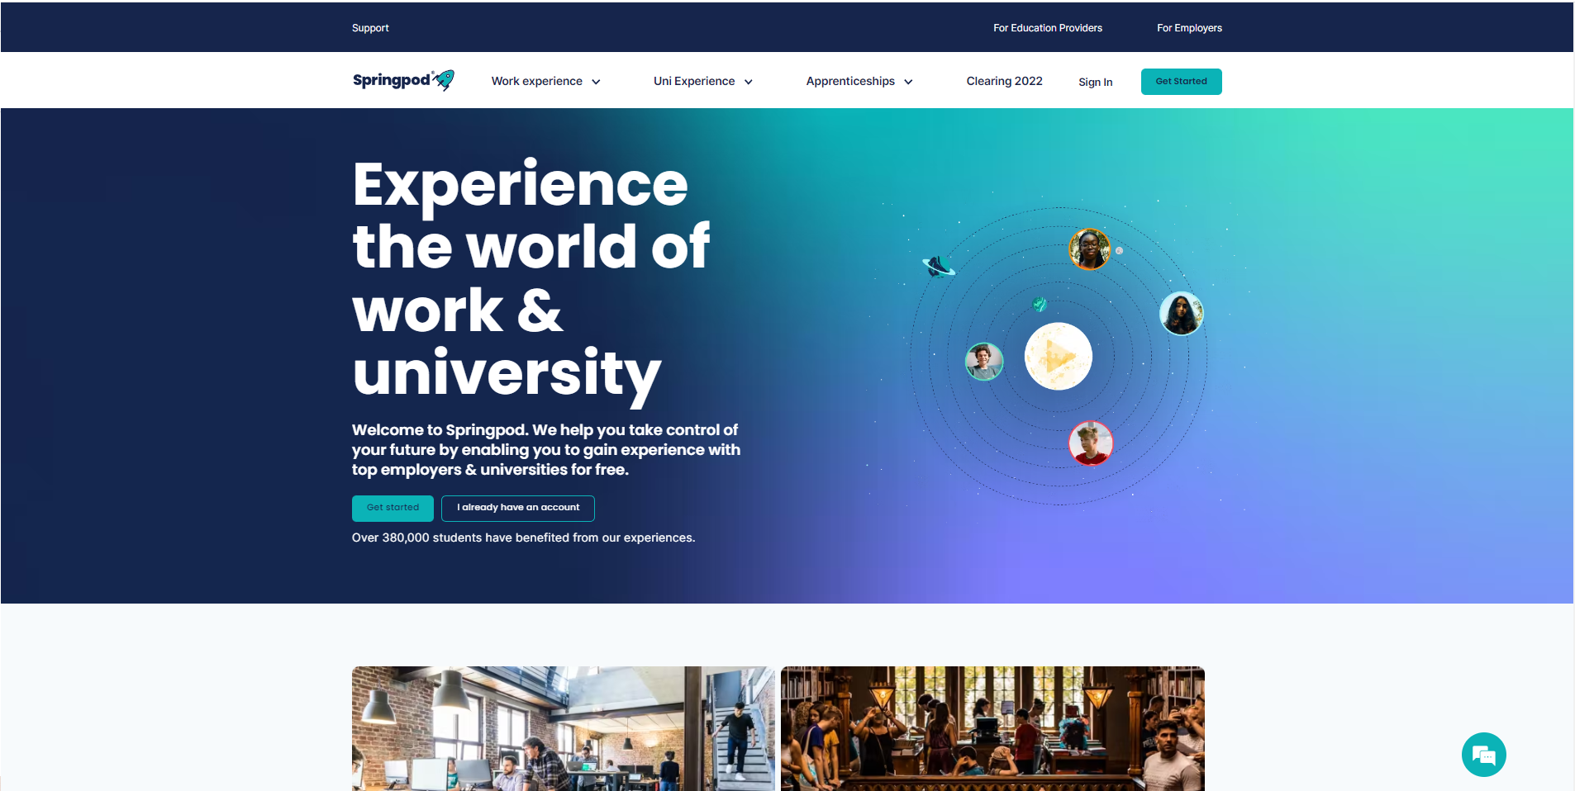
Create your account
Go to www.springpod.com
Click ‘Get Started’ in the top right corner
Select Student

Slide 2
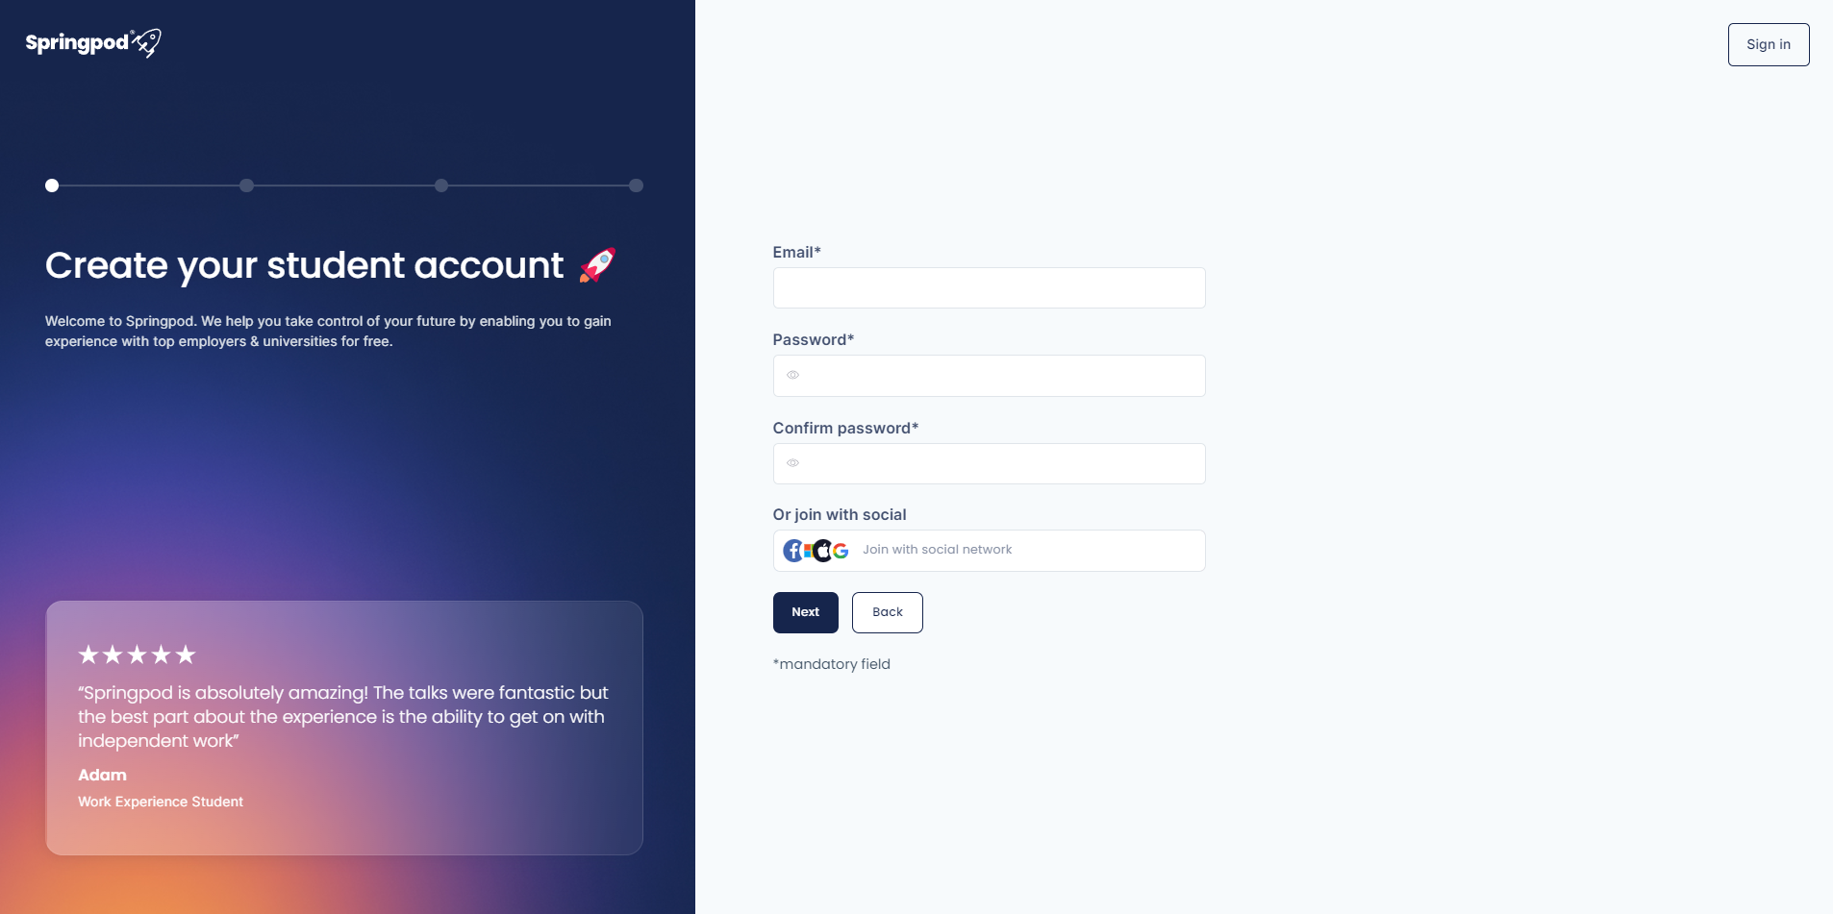
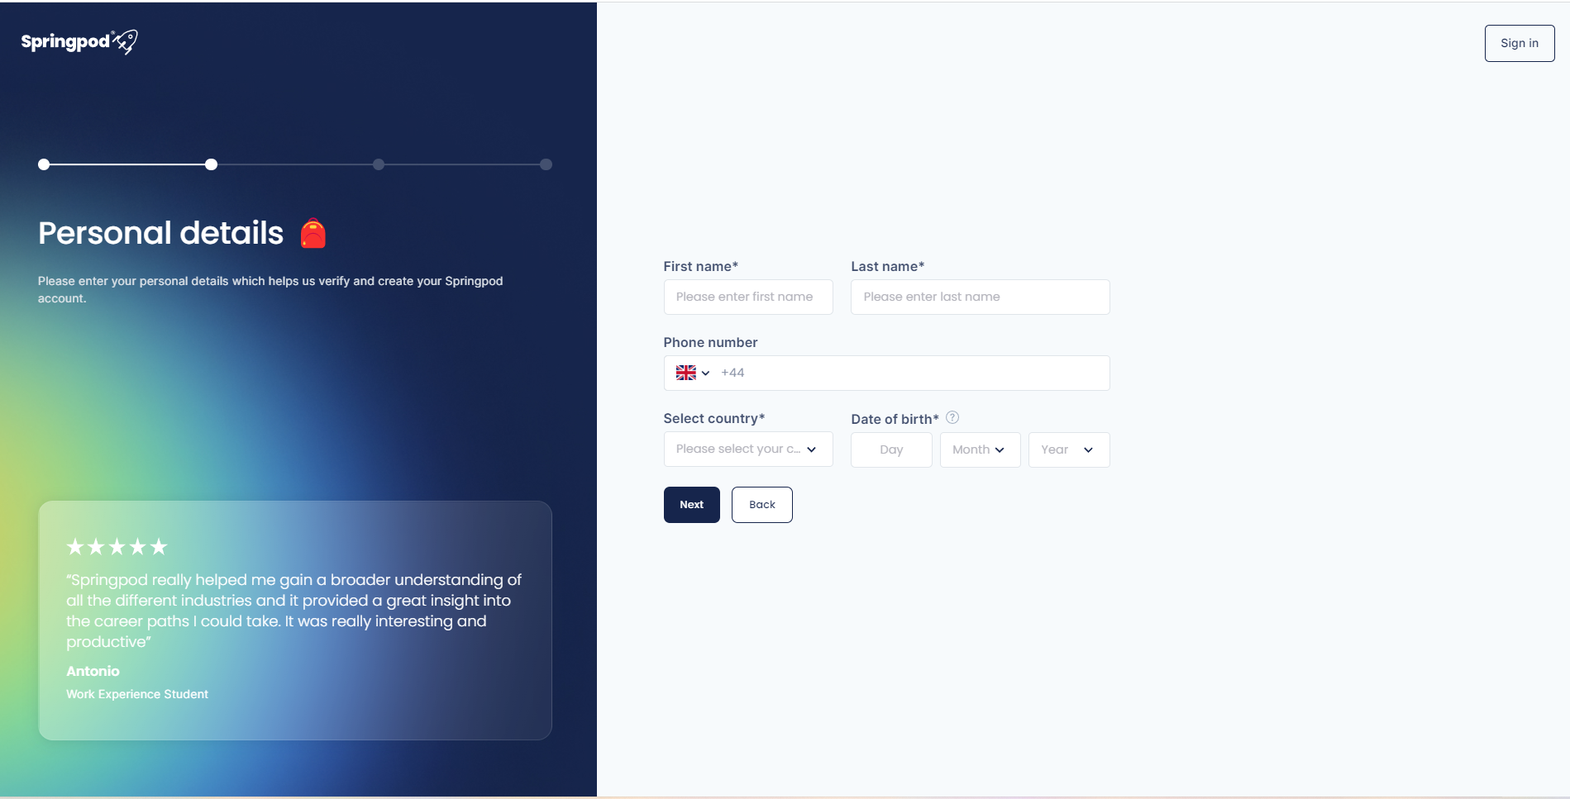
4. Add an email and create a password
5. Complete ‘Personal Details’

Slide 3
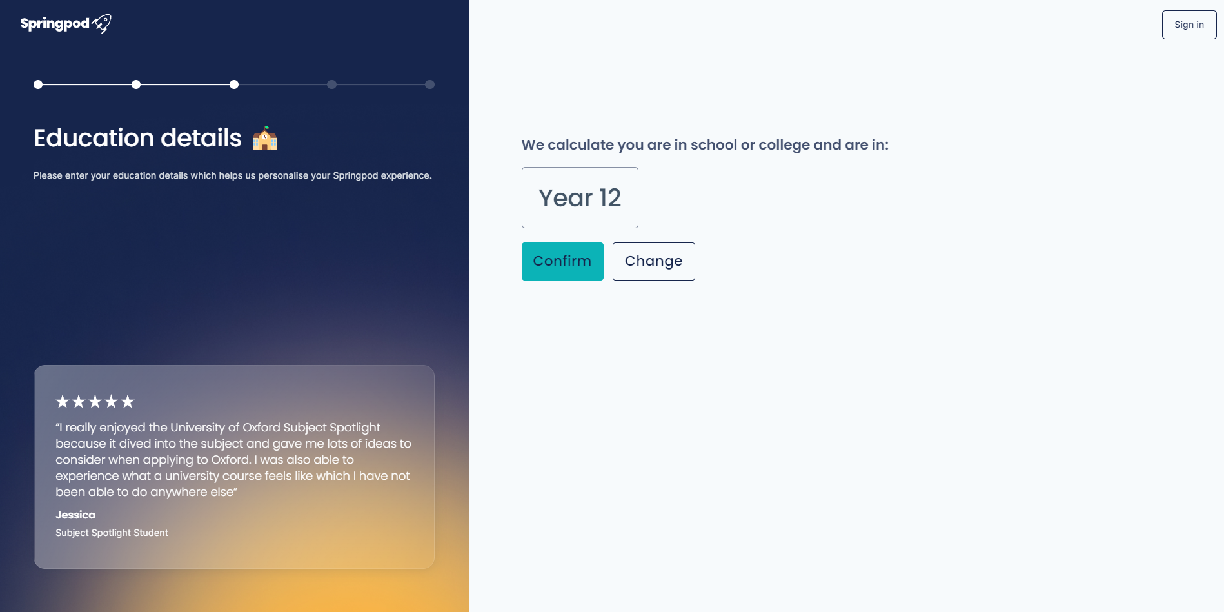
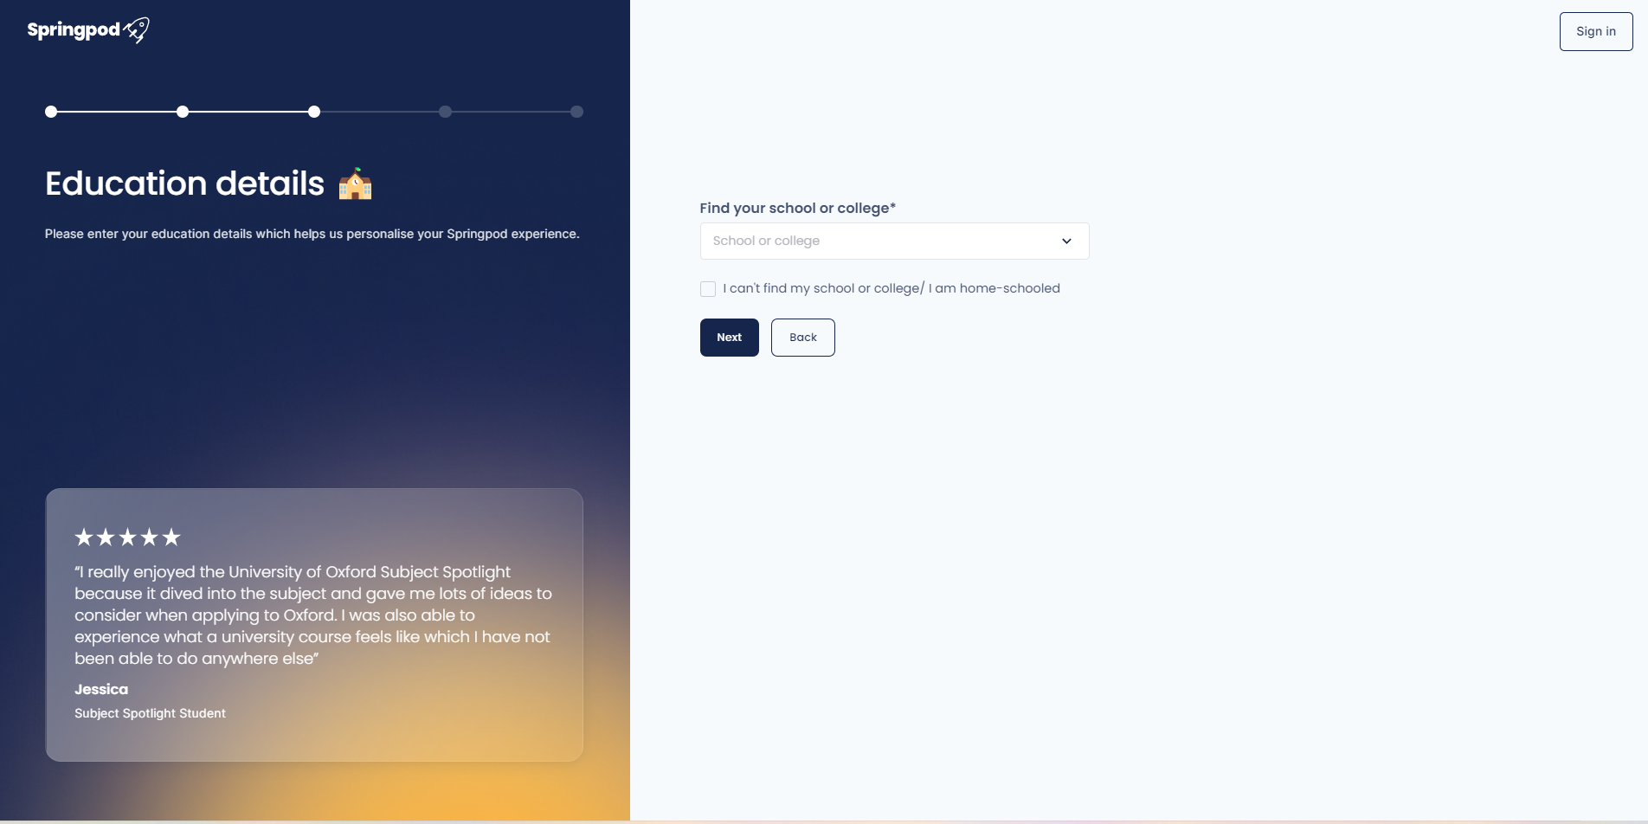
6. Confirm your Year Group
7. Find your School or College

Slide 4
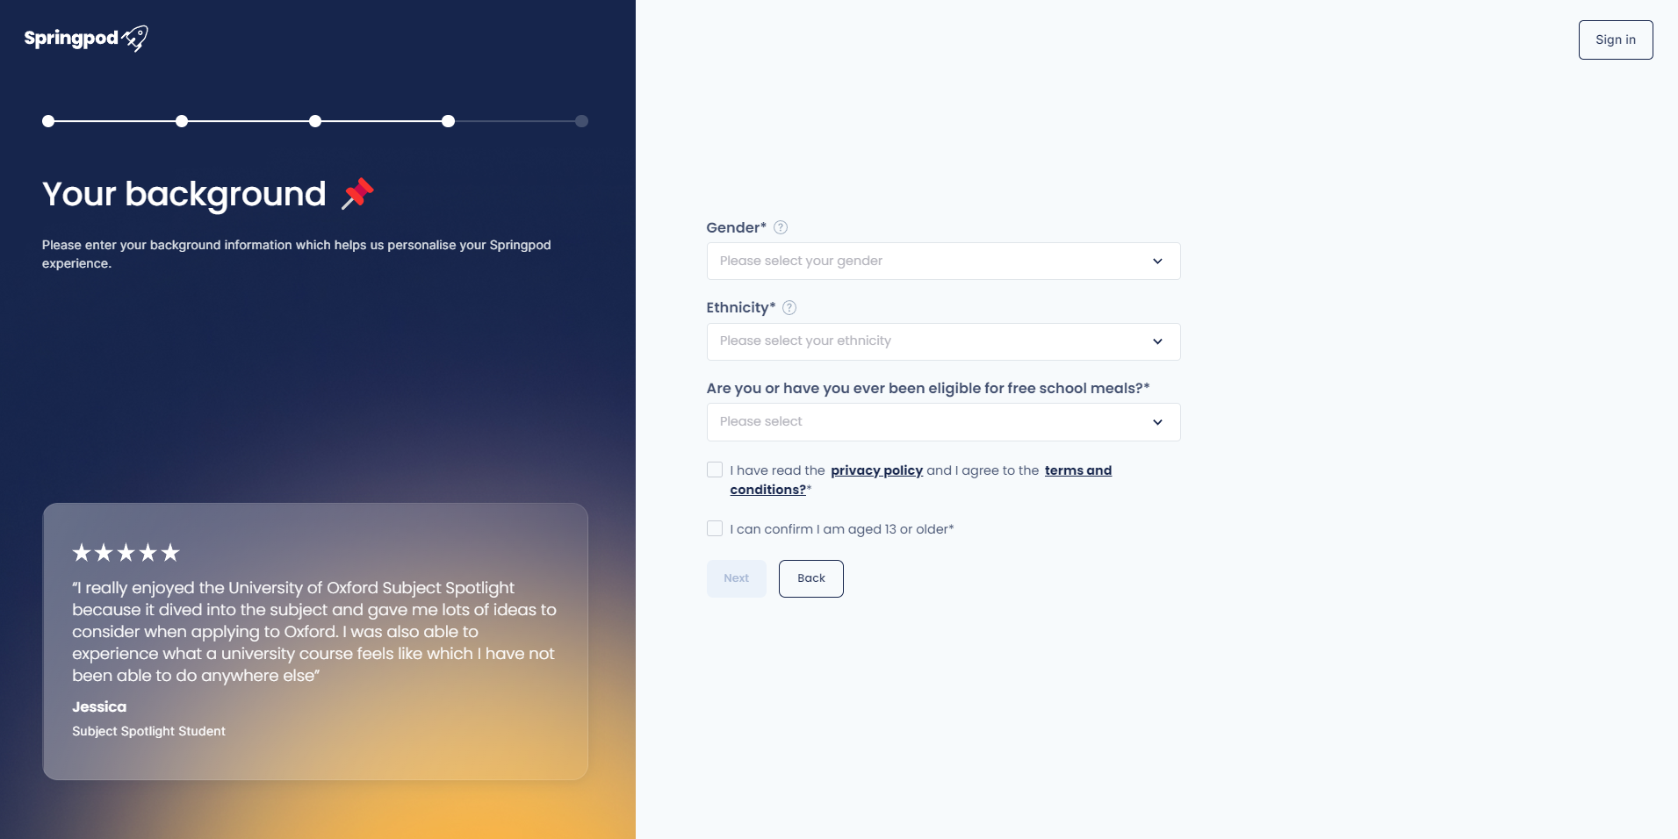
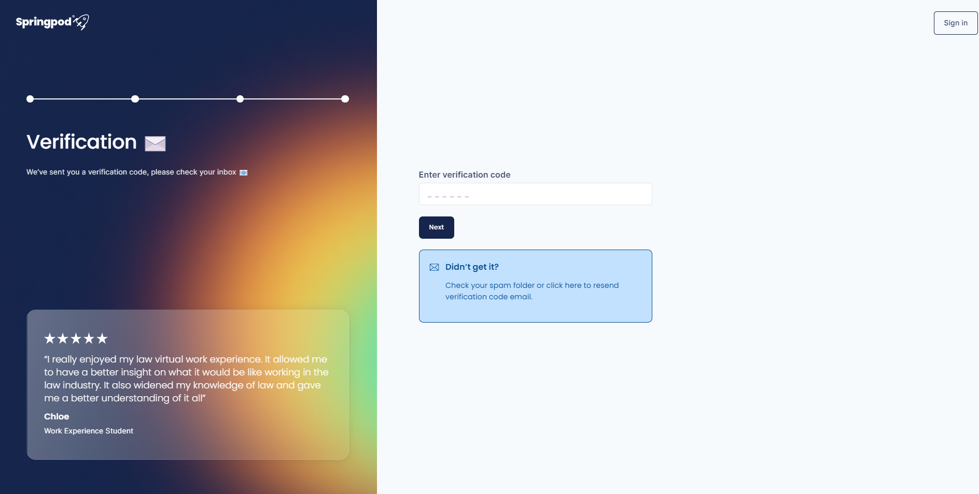
8. Complete your background
You can prefer not to say
9. Check your email for a verification code
Don’t forget to check your spam folder

Slide 5
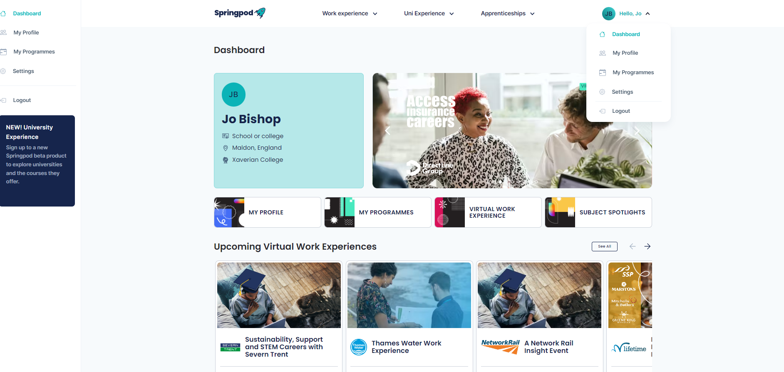
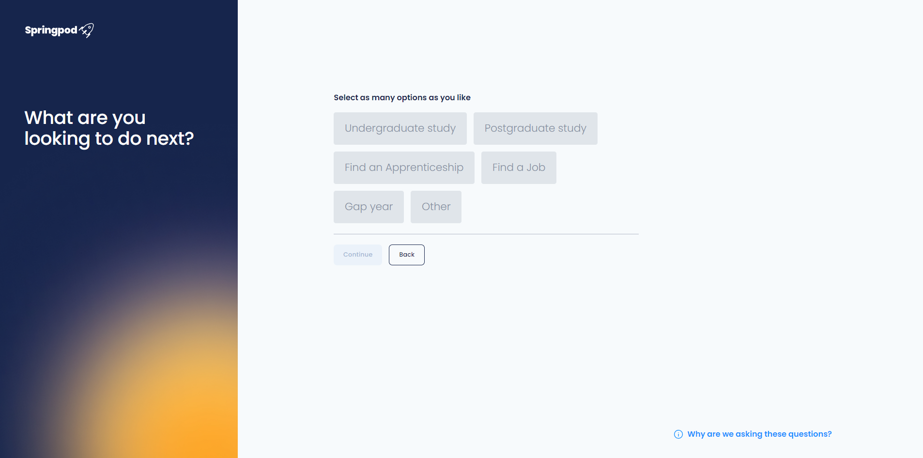
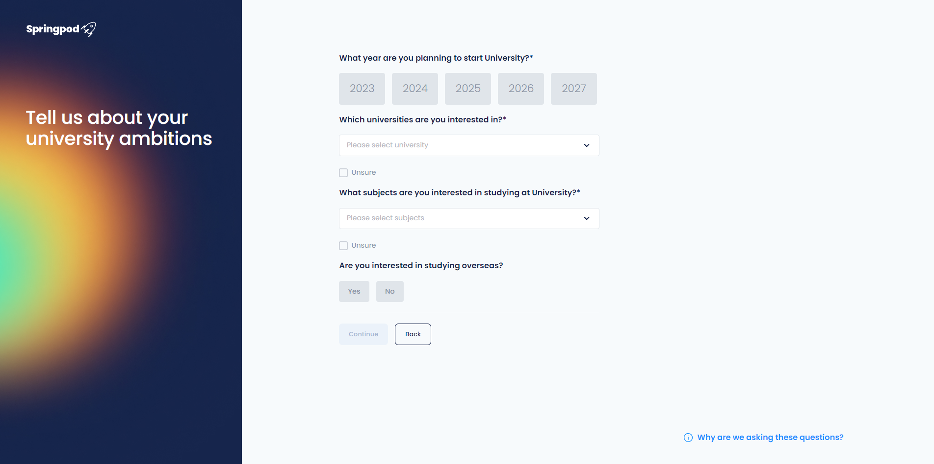
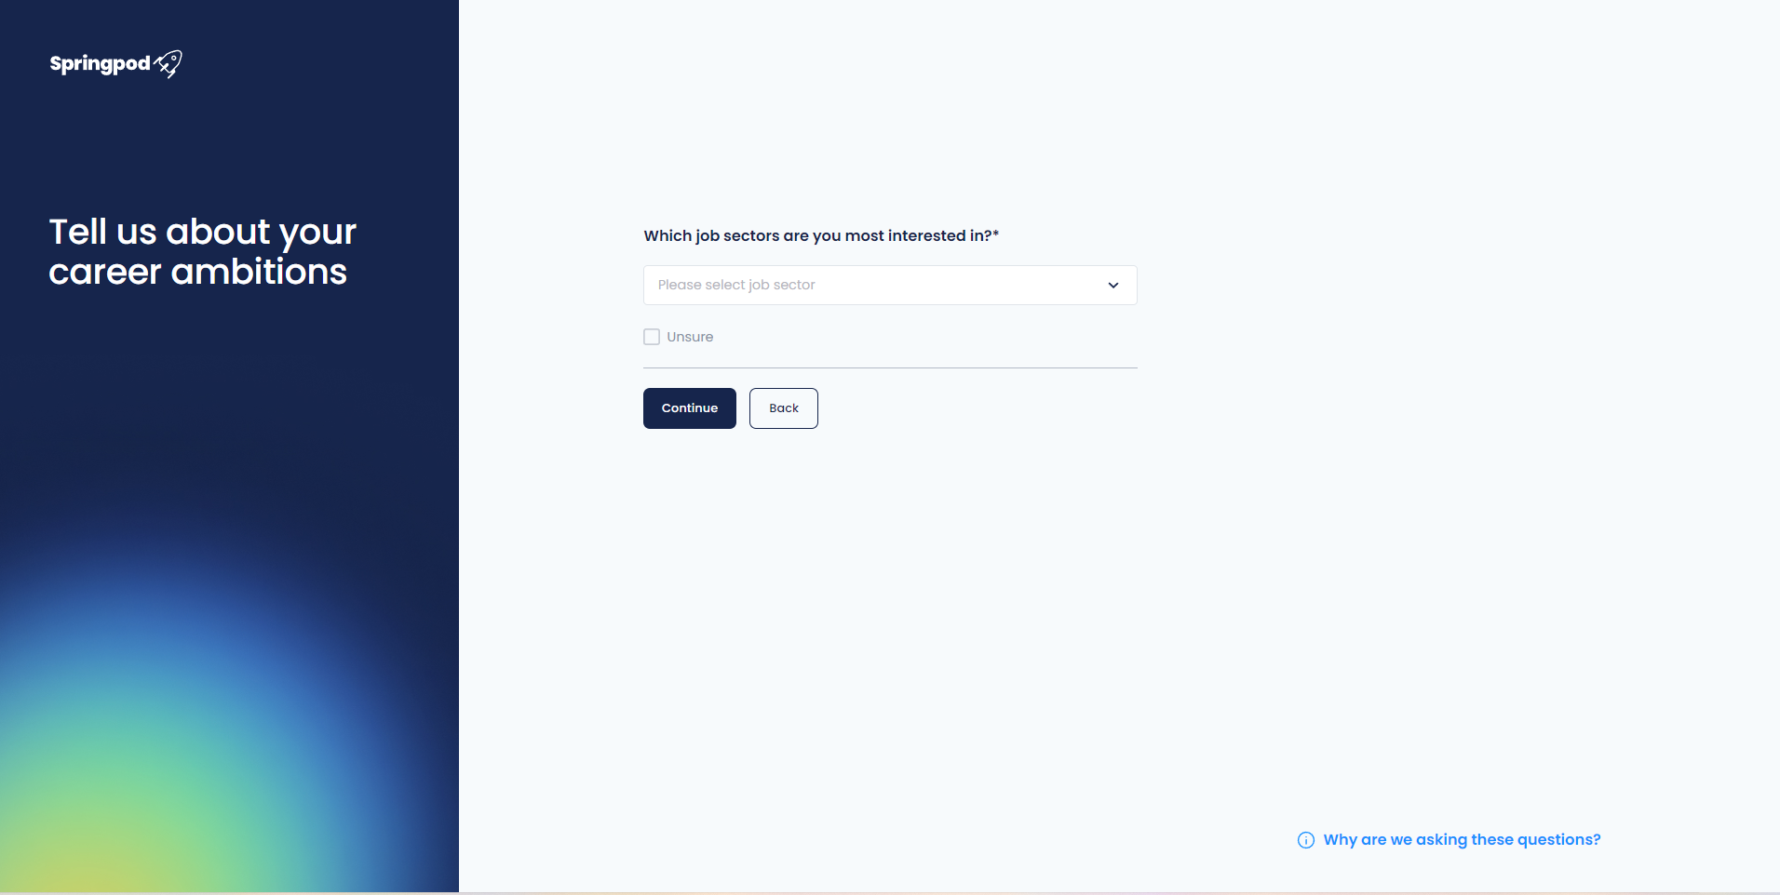
10. You can now go to your Dashboard and you will be prompted to complete your profile to personalise your Springpod experience

Slide 6
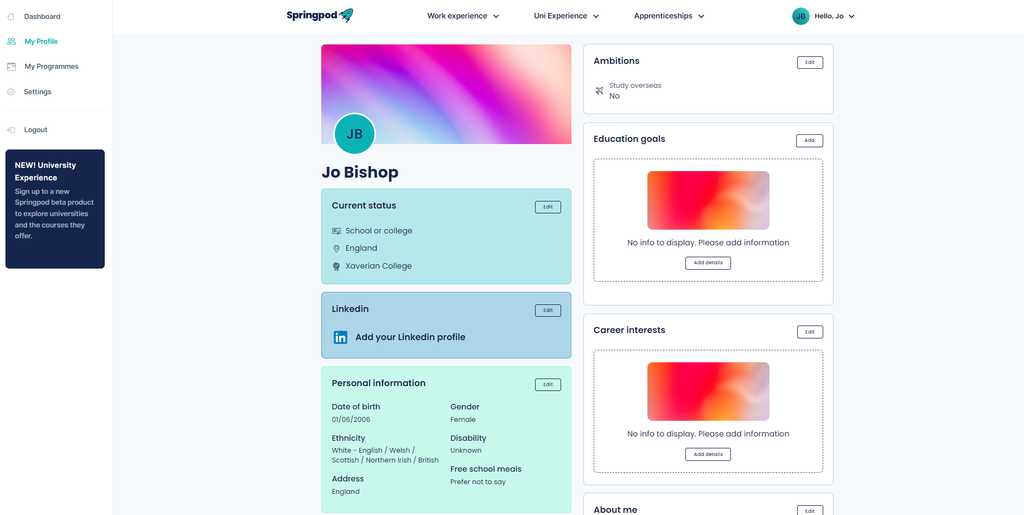
Welcome to Springpod!
This is your Dashboard which will feature the latest opportunities
You can add/edit your profile by clicking on the boxes ‘Education goals’ ‘Career interests’ ‘About me’ ‘Background’

